Slide 1
Final Project Hotel booking Analysis
Team Member: | Ruoyu Chen, Qing Dou, Zhengnan Li
Repository Link : | https://github.com/Zhengnan817/zhengnan.git

Slide 2


1.Introduction
Topic:
This project focused on predicting hotel booking cancellations using machine learning models and time-series analysis to assist hotels in managing operations more effectively. This is important for hotels because bookings can severely impact a hotel's revenue and related operational strategies.
Data Source:
Hotel reservations in Lisbon, Portugal from 2015 to 2017
Weather information in Lisbon.
Research Questions:
What are the key factors affecting hotel booking cancellation, and how can we predict the cancellations?
How can we predict hotel booking volumes using time series and ARIMA models?
KATZ SCHOOL

Slide 3

2.Research Approach
Machine Learning models
Logistic Regression
Neural Network
Decision Tree
Model Selection
Explanatory Data Analysis
Data Preparation
Ensemble Model
Conclusions
ARIMA & SARIMA
KATZ SCHOOL

Slide 4
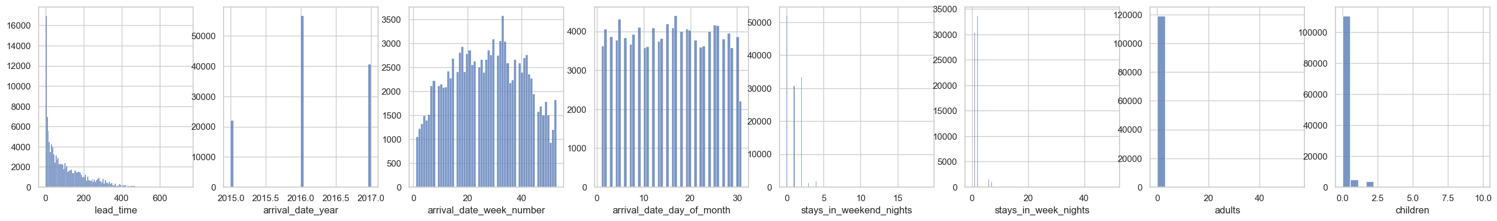
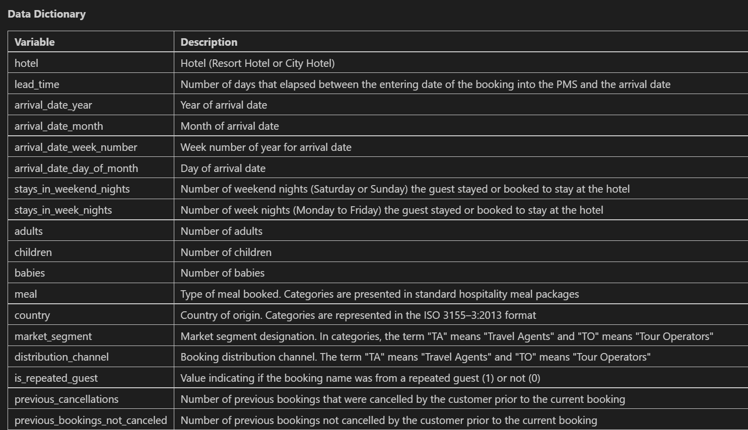
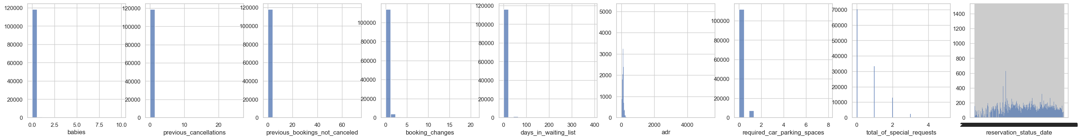
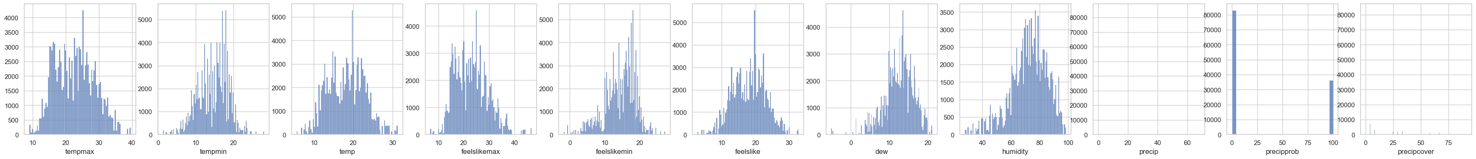
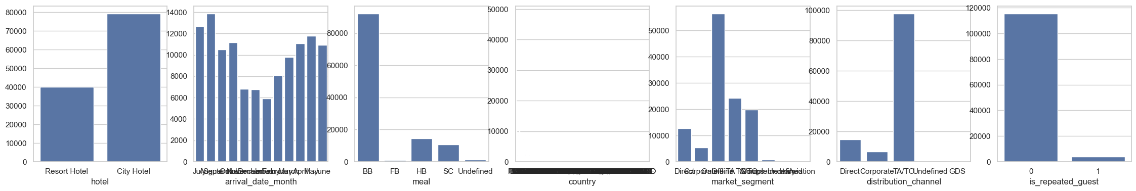
3.Exploratory Data Analysis
Dimension: 119,390 rows, 66 columns
…
4.Data Preparation
Check null values
Outliers
Feature Selection
Step Forward Selection
Data Transformation
KATZ SCHOOL

Slide 5
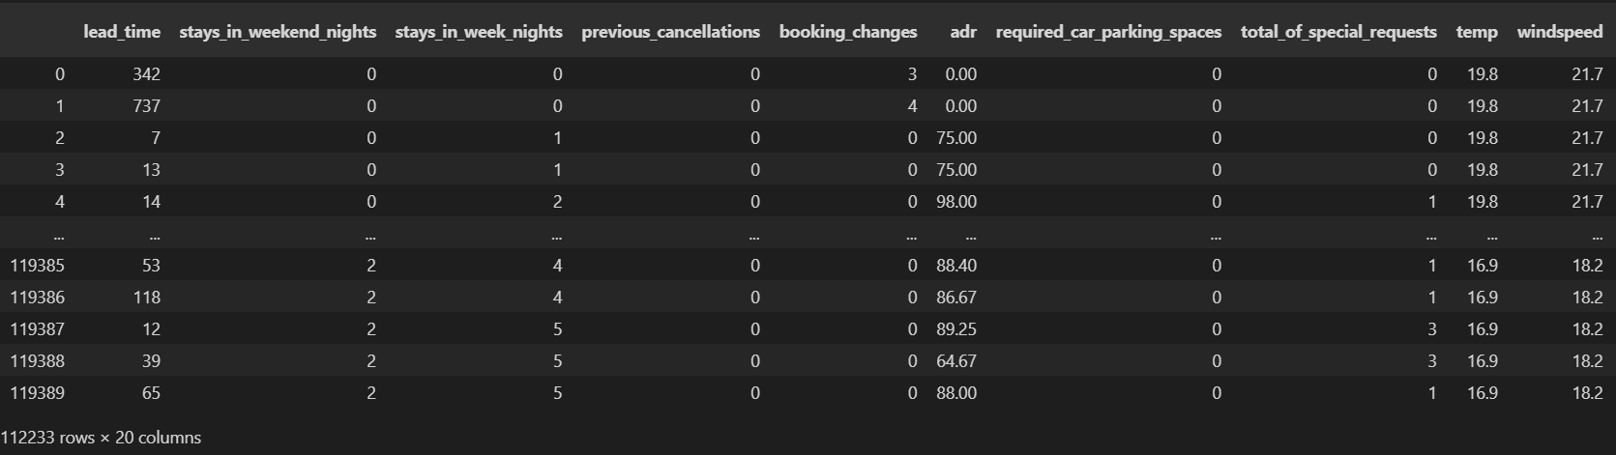
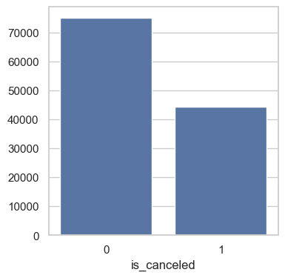
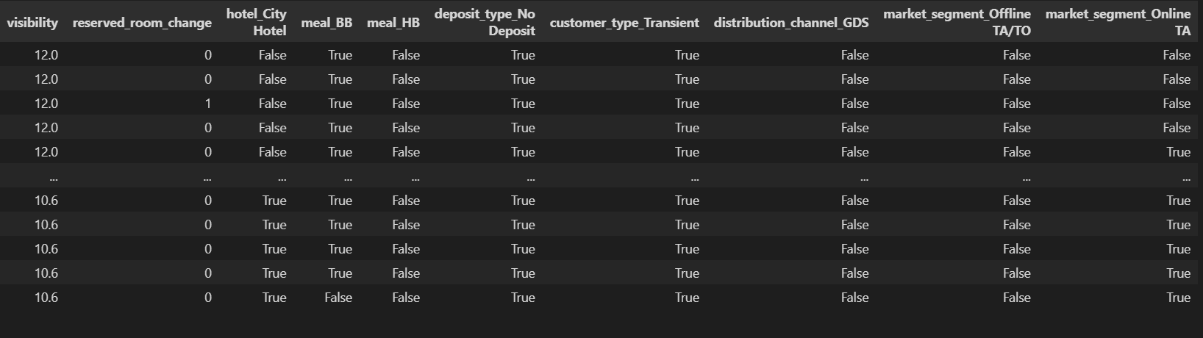
5.Prepped Data Overview
Target Variable
The data is slightly biased and the Null Error Rate is 0.62.
Explanatory Variable
The dimension of the dataset is 112,233 rows and 20 columns.
KATZ SCHOOL

Slide 6

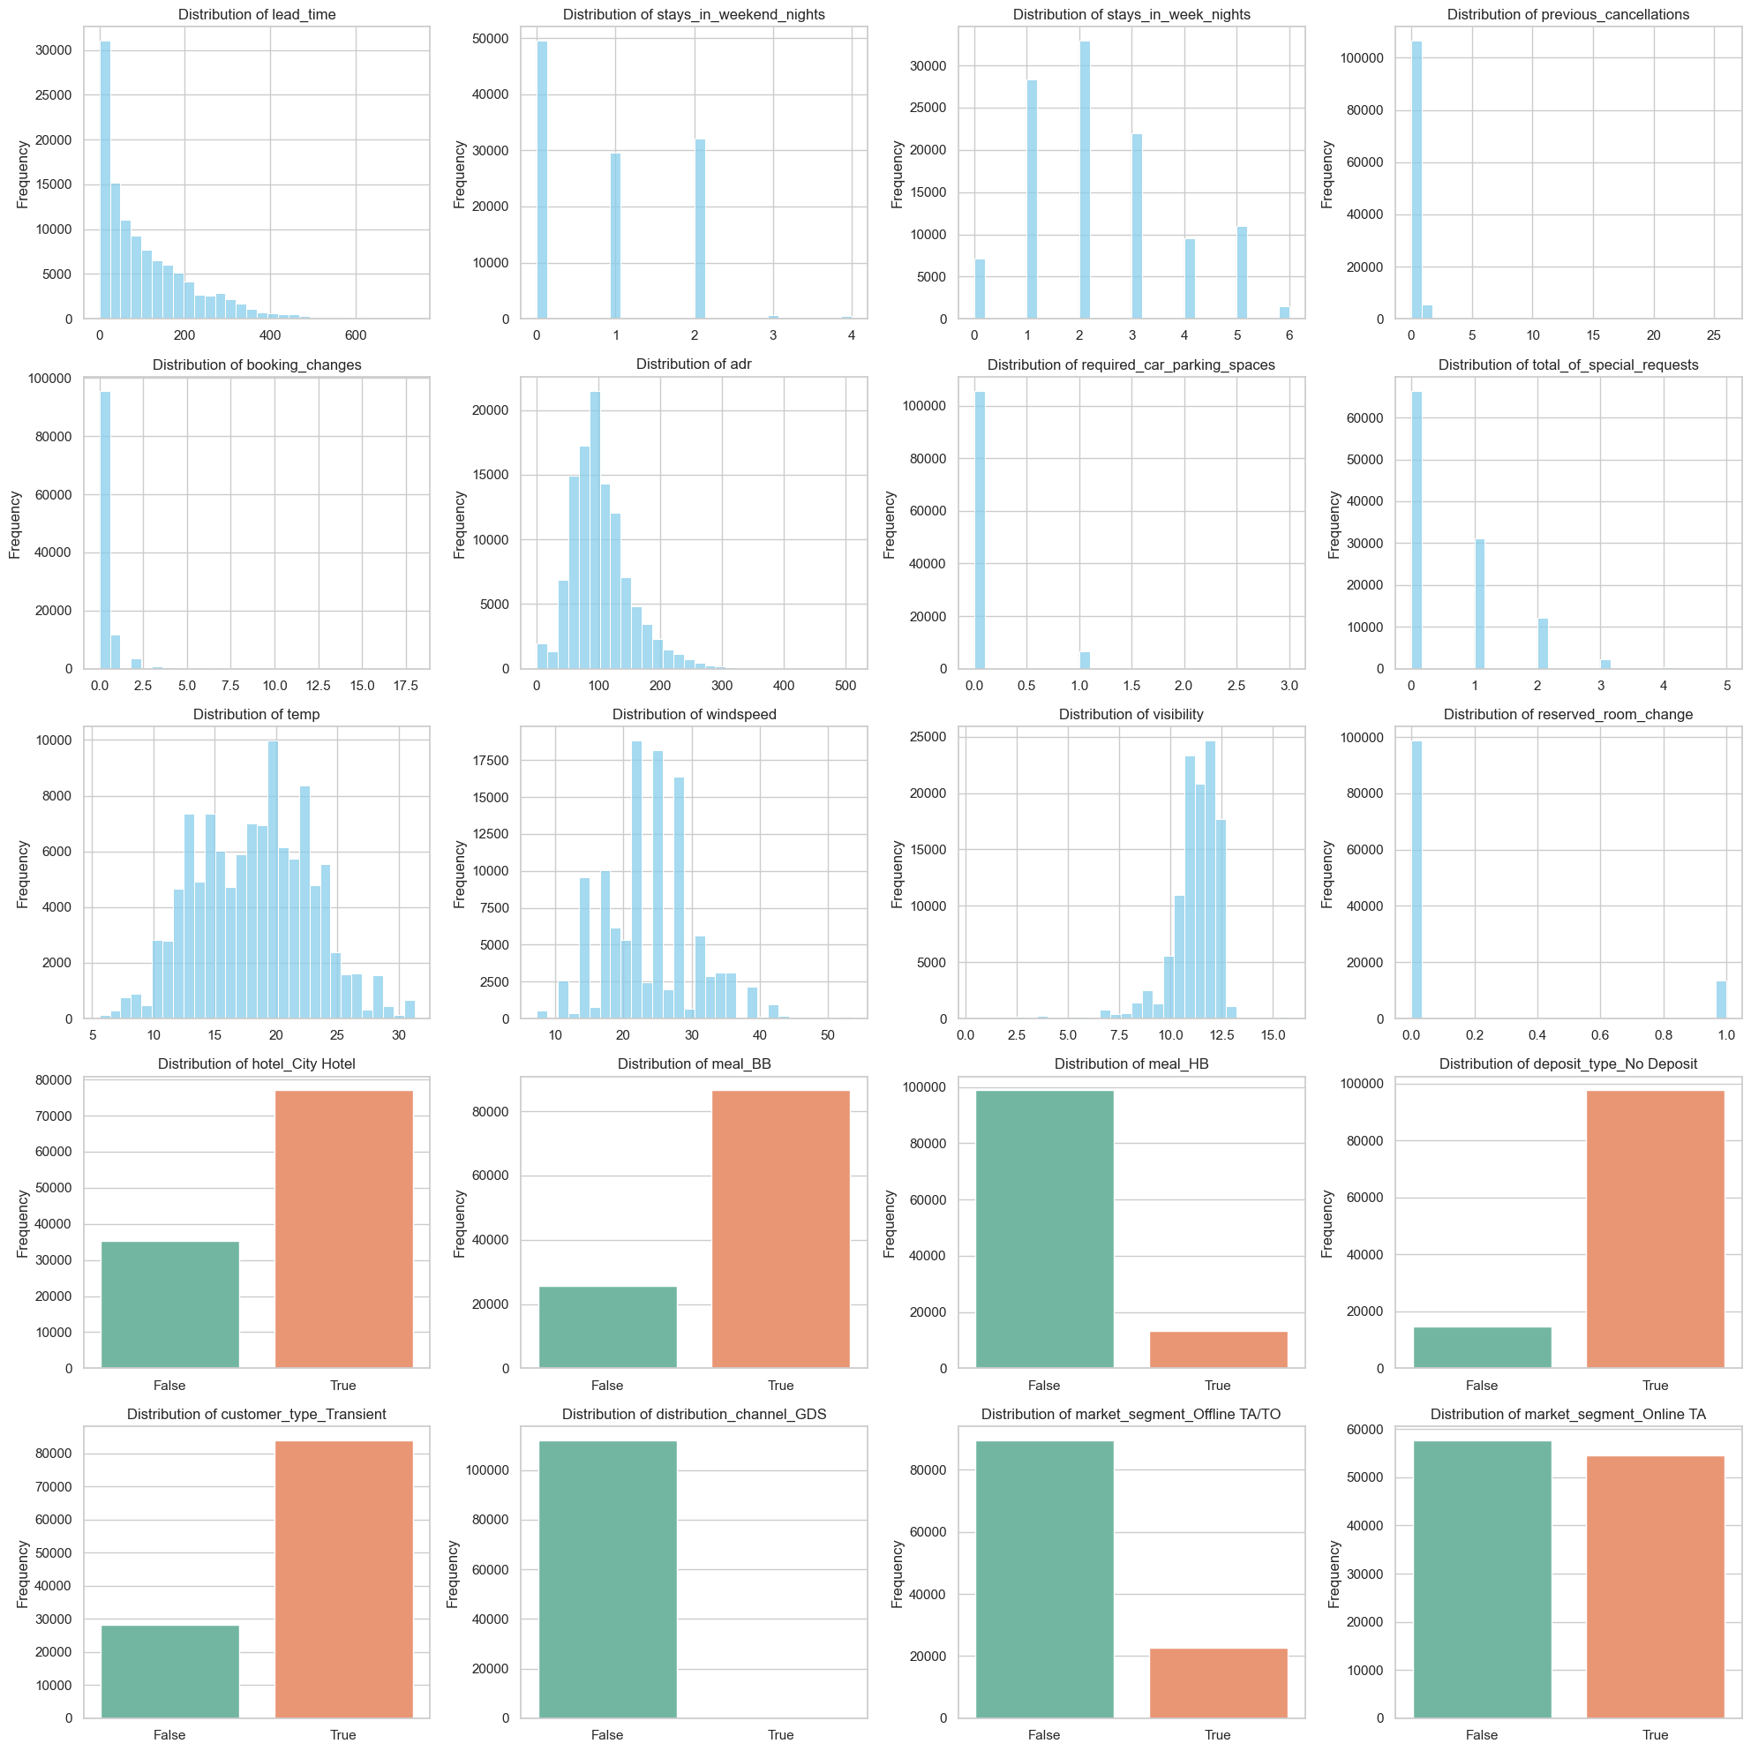
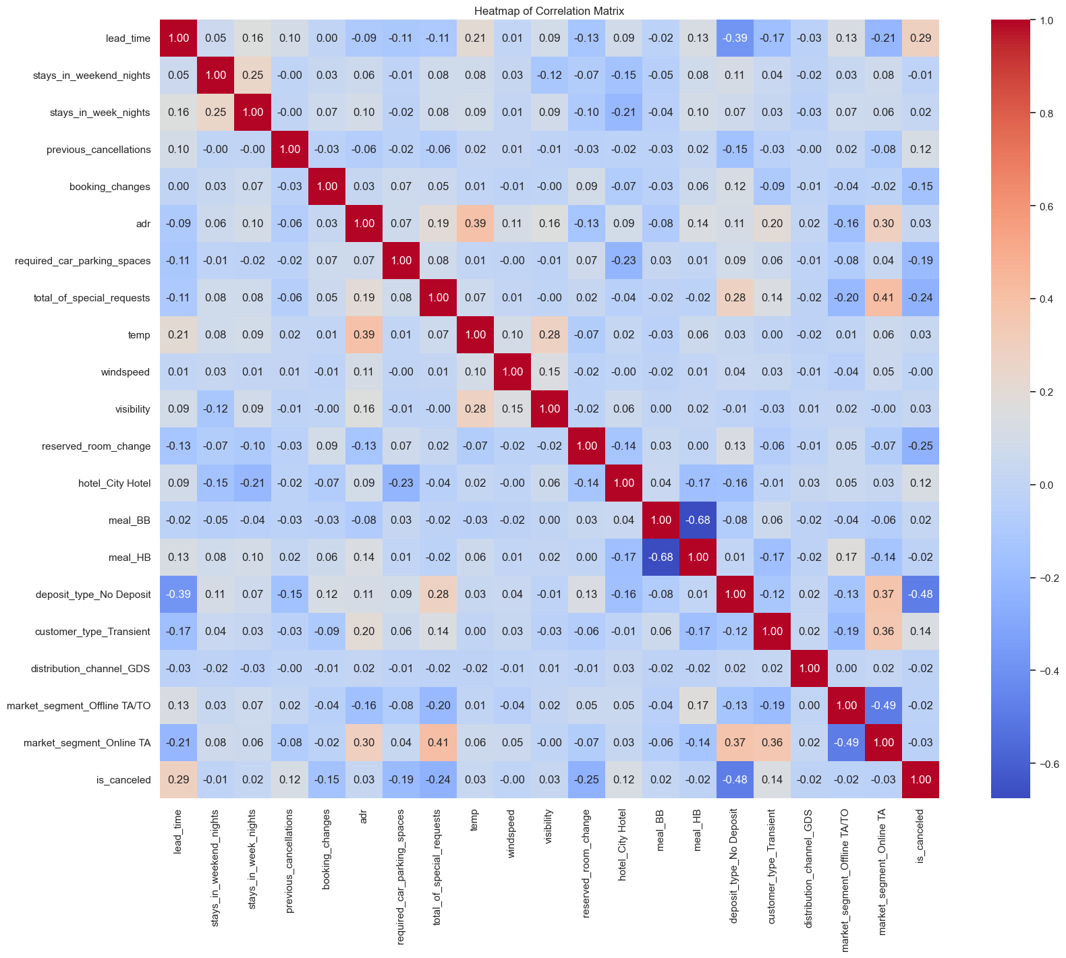
5.Prepped Data Review
columns = ['lead_time', 'stays_in_weekend_nights', 'stays_in_week_nights', 'previous_cancellations',
'booking_changes', 'adr', 'required_car_parking_spaces', 'total_of_special_requests', 'temp',
'windspeed', 'visibility', 'reserved_room_change', 'hotel_City Hotel', 'meal_BB', 'meal_HB',
'deposit_type_No Deposit', 'customer_type_Transient', 'distribution_channel_GDS',
'market_segment_Offline TA/TO', 'market_segment_Online TA']
KATZ SCHOOL

Slide 7
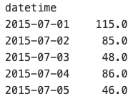
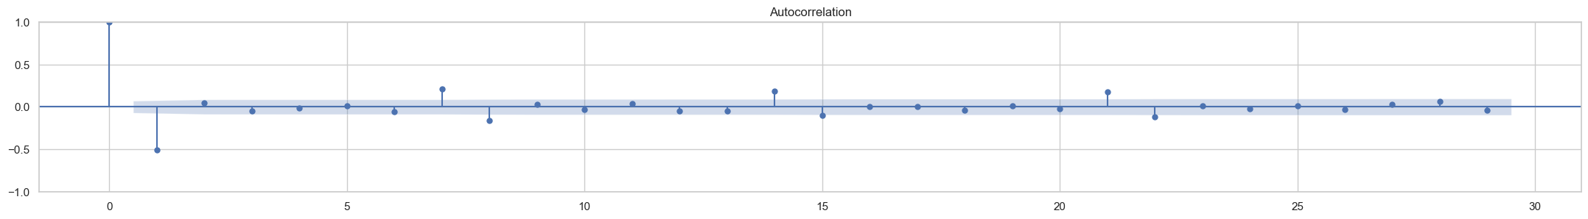
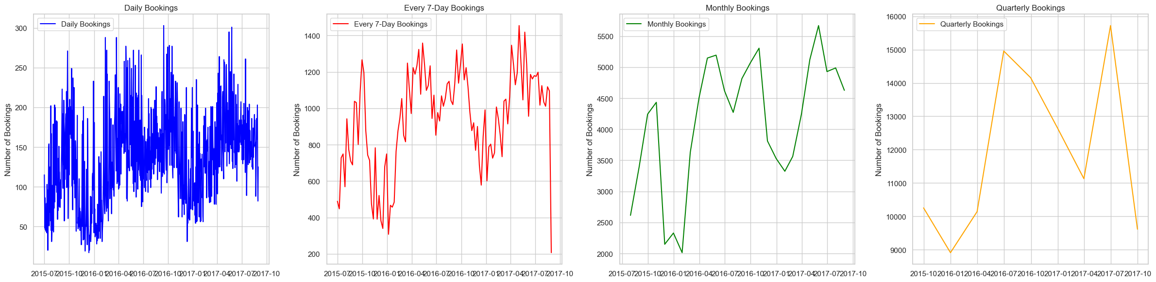
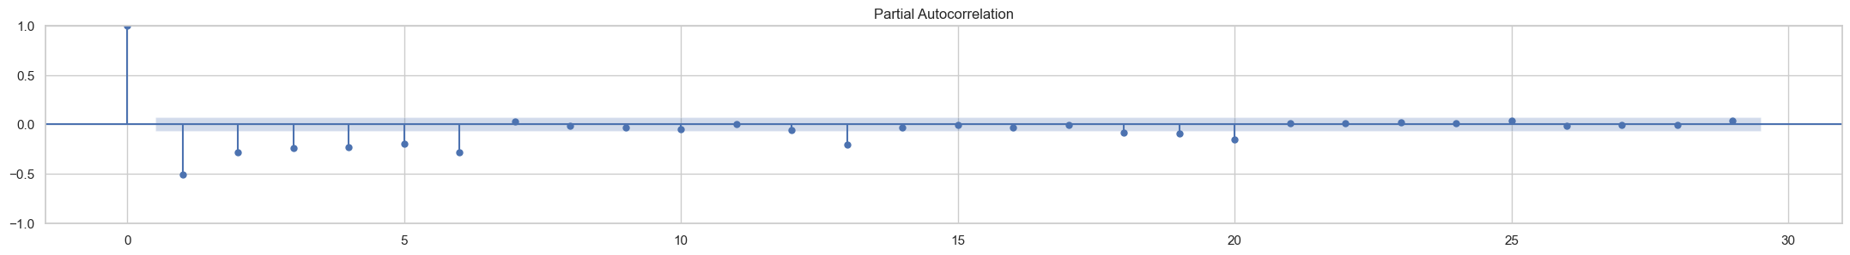
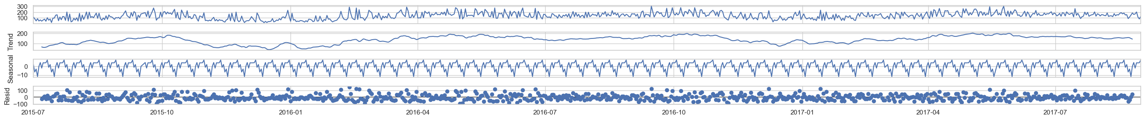
6.ARIMA Model
Hypothesis: The variations in hotel booking volumes are significantly influenced by inherent time series trends.
Using set_index function to transform the data into time series type.
Critical Values: 1%: -3.439 5%: -2.865 10%: -2.569
Reject the null hypothesis (H0), the data does not have a unit root and is stationary.
hotel.set_index('datetime', inplace=True) daily_bookings = hotel.resample('D').size()
ACF& PACF
p=0 (autoregressive order): First lag is insignificant.
d=1 (difference order): Perform first differencing.
q=0 (moving average order): autocorrelation coefficients for all lags are low and close to 0, moving average order q is probably also 0.
Plot the data in different periods(Daily, Weekly, Monthly and Quarterly).
Using daily bookings to do the analysis.
(6.1.1)
(1.1.1)
(0.1.0)
Remove 5 outliers
Seasonal Decompose
Trend: Slight fluctuations
Seasonal: Regular, Consider seasonal components
Residual: Randomly, Captured the trend and seasonality in the data well.
model = ARIMA(daily_bookings_diff,
order=(0, 1, 0))
model_fit = model.fit()
sarima_model_daily = SARIMAX(dailyly_bookings,
order=(0, 1, 0),
seasonal_order=(0, 1, 0, 30))
sarima_result_daily = sarima_model_daily.fit()
Log Likelihood | -4772.657
AIC | 9547.313
BIC | 9551.969
Sigma2 P value | 0.000
MSE | 5.415
RMSE | 7.358
Log Likelihood | -766.940
AIC | 1539.881
BIC | 1553.729
Sigma2 P value | 0.000
MSE | 18079.214
RMSE | 134.458
ADF
ADF Statistic: -2.214810
p-value: 0.200914
first differencing
ADF Statistic: -11.332986 p-value: 0.000000
KATZ SCHOOL
Notes:
Test whether a time series is stationary
Critical Value (5%) > Test Statistic
p-value < 0.05
The seasonal feature maybe lost when do the outliers and differecing. But if we keep the differencing and outlier. The data is not stationary and the in-sample result is totally wrong.

Slide 8
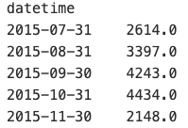
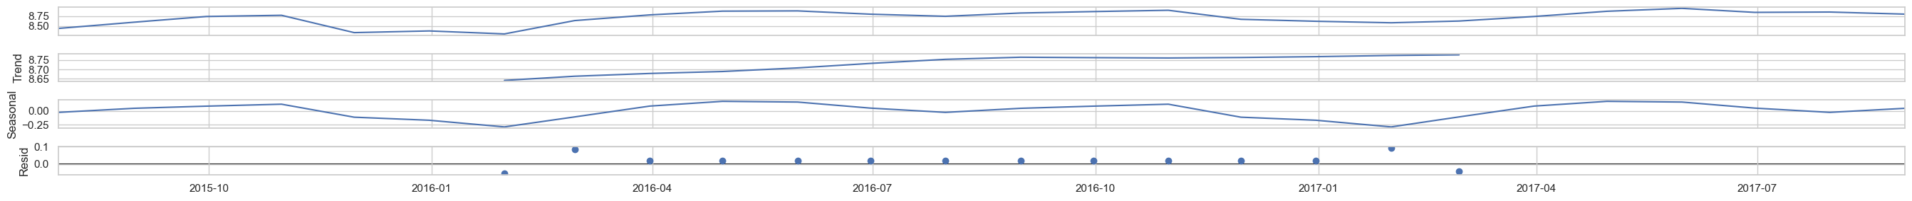
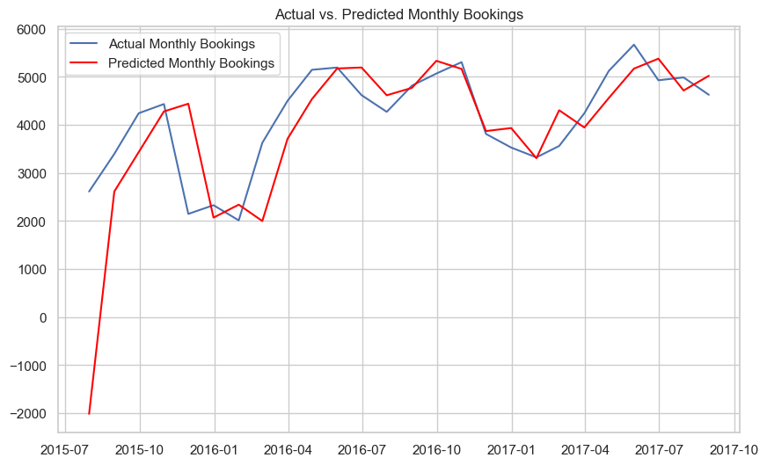
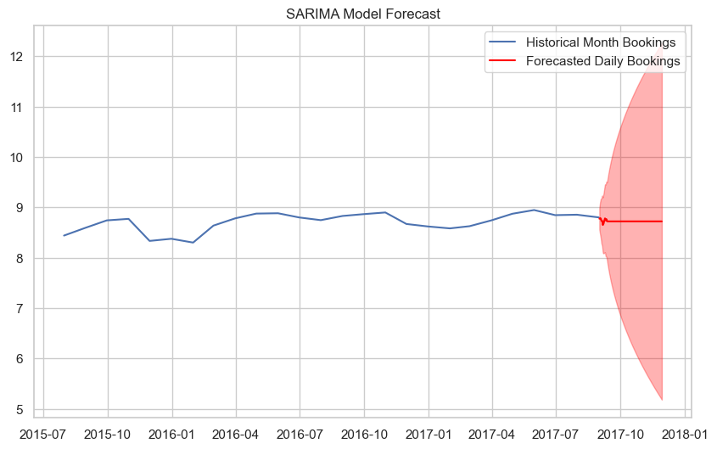
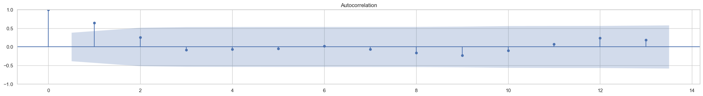
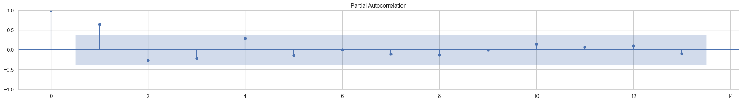
6.ARIMA Model
ACF (autocorrelation function) and PACF (partial autocorrelation function) plots are often used to make preliminary judgments about the parameters p and q of the ARIMA model.
Using set_index function to transform the data into time series type.
sarima_model_monthly = SARIMAX(monthly_bookings_log,order=(0, 1, 1),
seasonal_order=(0, 1, 1, 12))
month_results = sarima_model_monthly.fit()
monthly_bookings = daily_bookings.resample('M').sum()
Log Likelihood | 10.312 | ma.L1 | 0.882
AIC | -10.623 | ar.S.L12 | 0.971
BIC | -7.799 | ma.S.L12 | 0.745
MSE | 1312665.261 | Sigma2 P value | 0.970
RMSE | 1145.716
Using monthly bookings to do the analysis.
Seasonal Decompose
Trend: Slight fluctuations
Seasonal: Light Regular, Consider seasonal components
Residual: Randomly, Captured the trend and seasonality in the data well.
In-sample Forecast
Out-sample Forecast
ADF
ADF Statistic: -2.653733
p-value: 0.082392
first differencing
ADF Statistic: -3.298767
p-value: 0.014934
ACF& PACF
p=1 (autoregressive order): First lag is significant.
d=1 (difference order): Perform first differencing.
q=1 (moving average order): First lag is significant.
Conclusion：
Daily Cycle Model indicating the model are not good fit for the data. Monthly cycle model fits the data better but has a large prediction error.
ACF and PACF show that most lags are not significant, and the parameters of the model mostly have high p-values, which indeed may indicate that there is no significance in the data.
The hypothesis that only time factor significantly affects booking quantity is rejected.
We can consider using machine learning models and other variables to predict the number of reservations or whether to cancel reservations.
KATZ SCHOOL
Notes:
Confidence interval

Slide 9
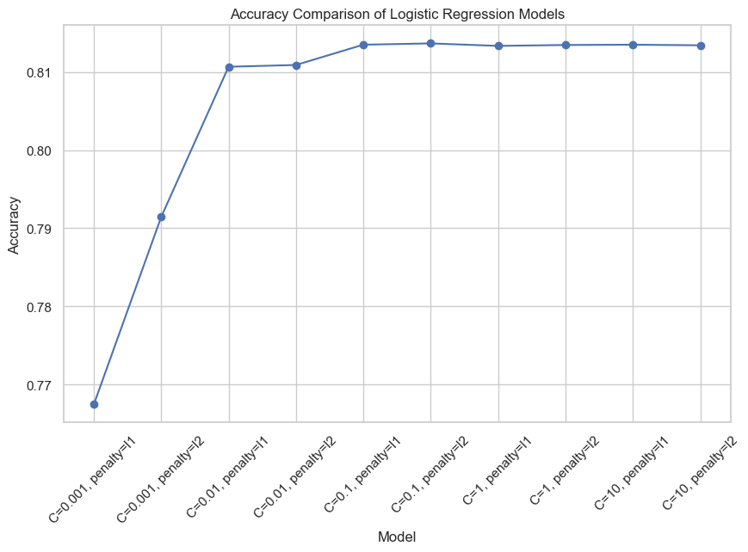
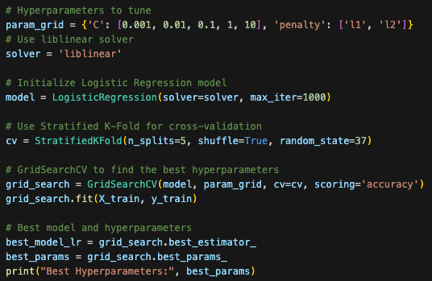
6.2 Logistic Regression
Using GridSearchCV to tune hyperparameters of a logistic regression model with a liblinear solver.
Optimized the model by testing various C values and penalty types with the liblinear solver.
Stratified K-Fold cross-validation (5 folds) ensures balanced class distributions.
The best model is selected based on accuracy, which is plotted for different hyperparameter combinations.
Finally, the best model is evaluated on the test set, with metrics like accuracy, Roc and Auc, R-squared, precision, recall, F1 score, and the confusion matrix calculated for comprehensive evaluation.
Metric | Cross Validation | Logistic Regression
Accuracy | 0.8096 | 0.8132
Precision | 0.8158 | 0.816
Recall | 0.8096 | 0.8132
F1 Score | 0.8022 | 0.8068
ROC AUC | 0.7735 | 0.7785
Confusion Matrix | N/A | [[19269, 1600], [4690, 8111]]
Best model selected with C: 1 and penalty: 'l2'.
KATZ SCHOOL
Notes:
Their mixed economies, encompassing agriculture, industry, and services, lead to varying energy demands.

Slide 10
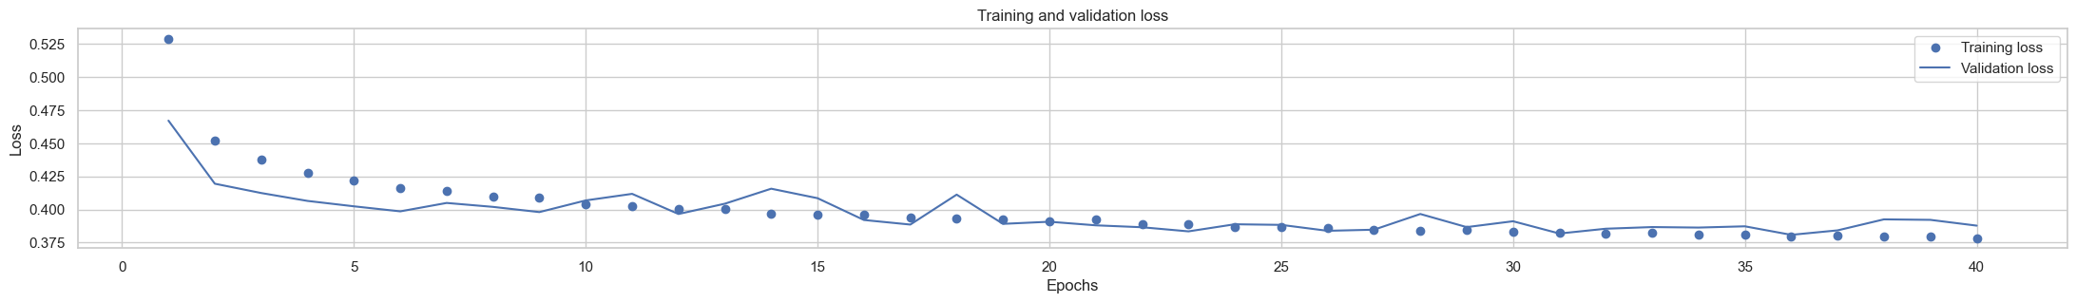
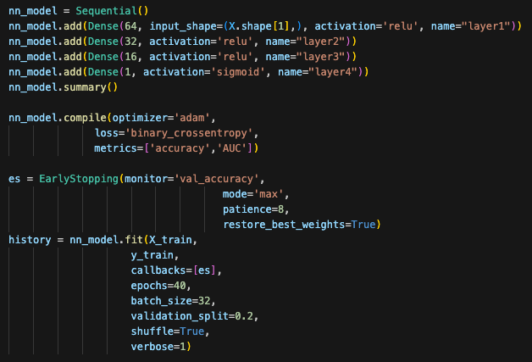
6.3 Neural Network
Using keras API to build a sequential model with 4 layers
The training loss and vilidation loss is gradually declining.
The model has 4 Dense layer, the first layer start with 64 neurons and activation function of 'relu'. Followed by layer 2 with 32 neurons, layer3 with 16 neurons. Finally a layer4 with function 'sigmoid' to output the probability of the target variable. The model was trained with an EarlyStopping callback to avoid overfitting.
Use the metrics to examine the model's performance. The model achieved a accuracy of 0.825 and F1 score of 0.822, with AUC score of 0.799.
Metric | Value
Accuracy | 0.8245
Precision | 0.8258
Recall | 0.8245
F1 Score | 0.8197
AUC Score | 0.7942
Layer (type) | Output Shape | Param #
layer1 (Dense) | (None, 64) | 1,344
layer2 (Dense) | (None, 32) | 2,080
layer3 (Dense) | (None, 16) | 528
layer4 (Dense) | (None, 1) | 17
Confusion Matrix | Predicted Negative | Predicted Positive
Actual Negative | 19215 | 1668
Actual Positive | 4242 | 8545
KATZ SCHOOL
Notes:
Their mixed economies, encompassing agriculture, industry, and services, lead to varying energy demands.

Slide 11
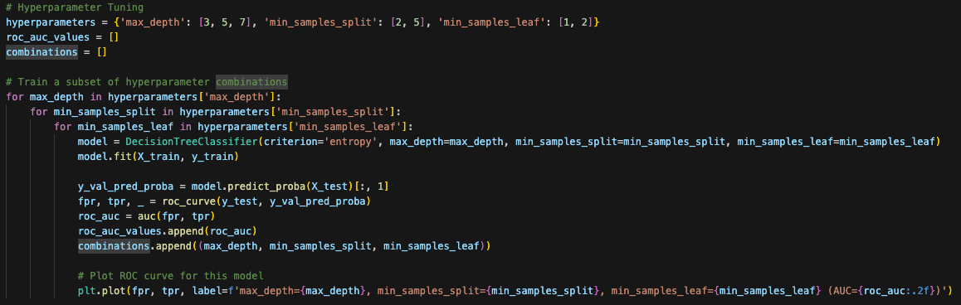
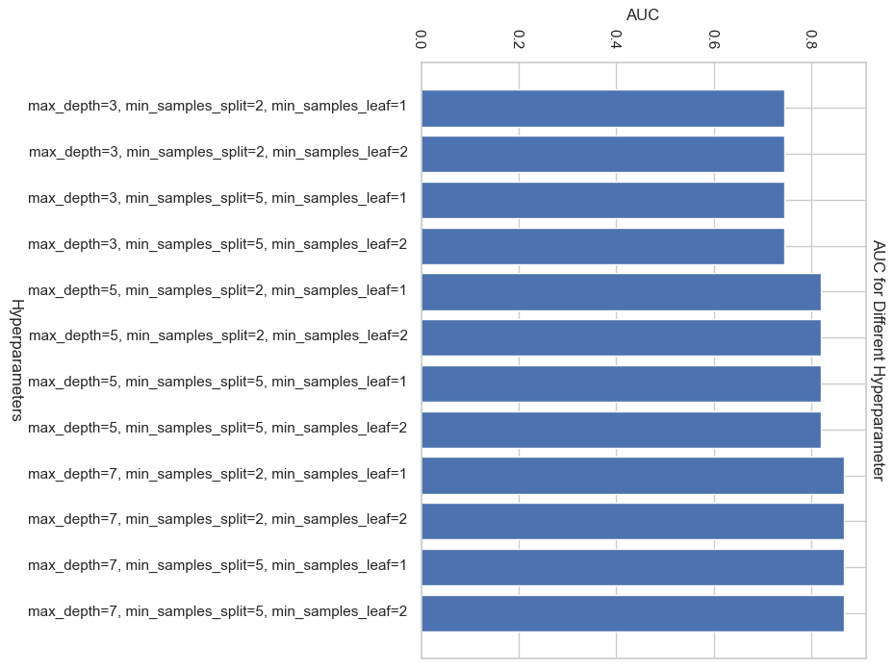
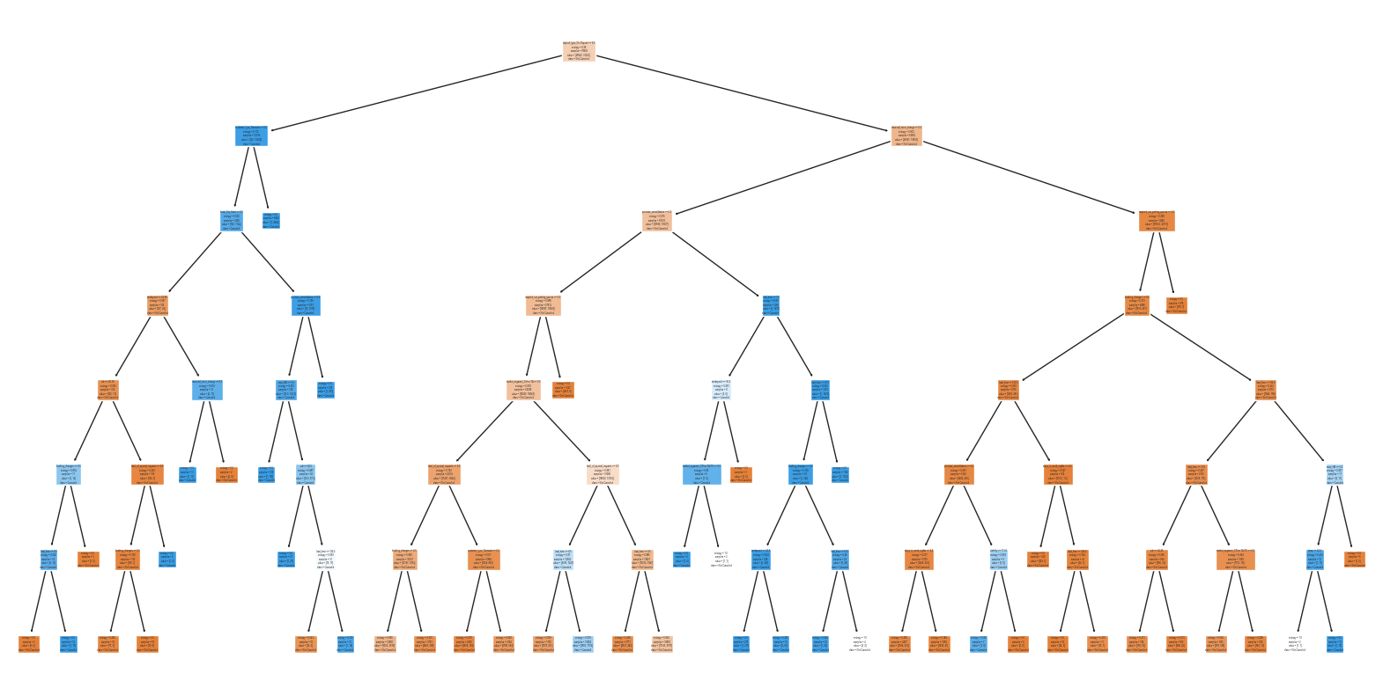
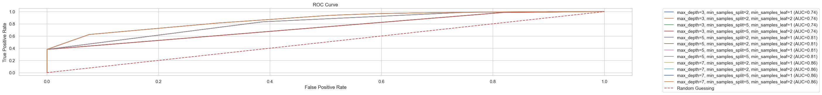
6.4 Decision Tree Model
Then trains a Decision Tree model with the optimal hyperparameters and evaluates the model's performance on the test set, including metrics like ROC AUC, accuracy, precision, recall, and F1 score.
Performs hyperparameter tuning for a Decision Tree model by experimenting with different combinations of max_depth, min_samples_split, and min_samples_leaf.
Metric | Cross Validation | Best Decision Tree
Accuracy | 0.7687 | 0.8131
Precision | 0.7732 | 0.8162
Recall | 0.7687 | 0.8131
F1 Score | 0.7599 | 0.8065
ROC AUC | 0.7325 | 0.7777
Parameters | N/A | max_depth=7, min_samples_split=2, min_samples_leaf=2
AUC on Test Set | N/A | 0.87
Each model is trained and evaluated on the test set to compute its ROC AUC, and the best model is selected based on the highest AUC score.
Visualizes the structure of the Decision Tree to interpret the model's logic.
the best model based on the highest AUC score. This model was selected with max_depth=7, min_samples_split=2, and min_samples_leaf=2.
KATZ SCHOOL
Notes:
Their mixed economies, encompassing agriculture, industry, and services, lead to varying energy demands.

Slide 12
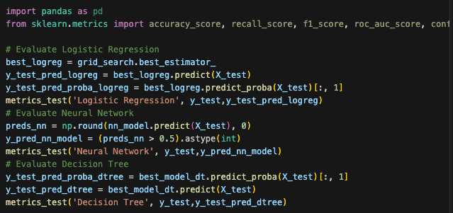
7 Model Selection
To select the best model, we evaluate three different models: Logistic Regression, Neural Network, and Decision Tree. Analyze their performance based on accuracy, precision, recall,F1 score and AUC.
The Neural Network model seems to be the best overall performer, having the highest accuracy, recall, and F1 score, showing good balance between precision and recall.
Model | Accuracy | Precision | Recall | F1 Score | AUC
Logistic Regression | 0.8132 | 0.816 | 0.8132 | 0.8068 | 0.7784
Neural Network | 0.8186 | 0.8194 | 0.8186 | 0.8138 | 0.7883
Decision Tree | 0.8103 | 0.8136 | 0.8103 | 0.8034 | 0.7744
KATZ SCHOOL
Notes:
Their mixed economies, encompassing agriculture, industry, and services, lead to varying energy demands.

Slide 13
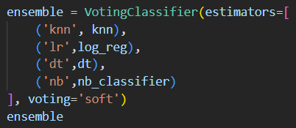
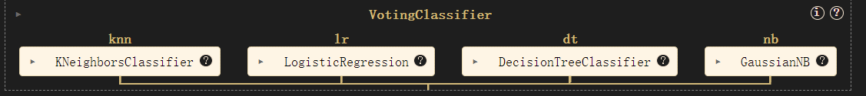
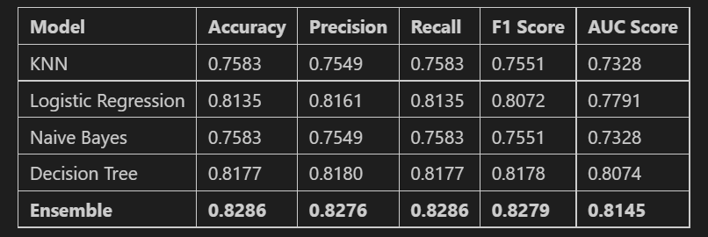
8.Ensemble Model
Combines the output of the individual component models by a VotingClassifier to calculate a prediction.
We also uses a 'soft' voting method to avoid when the votes are 2 against 2.
Using K-nearest neighbor, logistic regression, decision tree and naïve beyes.
Compared with the individual component models, the ensemble model has a better performance across all metrics.
KATZ SCHOOL
Notes:
Their mixed economies, encompassing agriculture, industry, and services, lead to varying energy demands.

Slide 14
8.Conclusions
- Key Factors Affecting Booking Cancellations
We analyzed various models to identify the key factors influencing booking cancellations. Through feature selection and model evaluations, we discovered that variables such as lead time, booking changes, and average daily rates played significant roles in determining the likelihood of cancellations. By accurately identifying these factors, hotels can implement targeted strategies, such as offering incentives for longer stays or adjusting cancellation policies, to reduce the impact of cancellations.
- Predicting Daily Hotel Booking Volumes Using Time-Series Analysis
To forecast hotel booking volumes and help optimize hotel strategy, we employed time-series analysis through SARIMA models on daily and monthly data. The analysis revealed consistent seasonal trends, enabling us to anticipate booking volumes with reasonable accuracy. Although the monthly cycle model did not provide a perfect fit, the Time-Series model still offers a valuable approach for forecasting.
- Machine Learning Model Performance
Among the machine learning models, the Neural Network model has a strong performance with high accuracy, recall, and F1 score. The Decision Tree model provided interpretability while achieving good accuracy, and Logistic Regression presented robust AUC scores. However, combining these models into an ensemble further improved prediction accuracy to 0.82 and improved on other metrics.
KATZ SCHOOL

Slide 15

8.Conclusions
In conclusion, our predictive models provide practical insights for hotels to anticipate booking cancellations and manage daily booking volumes.
By incorporating machine learning and time-series analysis, hotels can enhance operational efficiency and profitability. Future research could focus on refining these models with additional data sources and more advanced techniques to further improve prediction accuracy.
KATZ SCHOOL

Slide 16

9.Challenges
Thank You
1. Arima parameters optimizing
2. Build a Neural net work using Keras API
3. Ensemble component choice
Team Member: | Ruoyu Chen, Qing Dou, Zhengnan Li
Repository Link : | https://github.com/Zhengnan817/zhengnan.git
10.References
Dataset source: https://github.com/rfordatascience/tidytuesday/tree/master/data/2020/2020-02-11
Domain Knowledge:
Antonio, N., de Almeida, A., and Nunes, L. (2019). Hotel booking demand datasets: https://www.sciencedirect.com/science/article/pii/S2352340918315191
- https://keras.io/api/layers/
- https://scikit-learn.org/stable/modules/ensemble.html
- https://medium.com/luca-chuangs-bapm-notes/build-a-neural-network-in-python-binary-classification-49596d7dcabf
- https://medium.com/ai-advances/boost-your-ml-models-performance-with-ensemble-modeling-9d0d5df8f307
KATZ SCHOOL
Notes:
1In last class professor Molin mentioned that the api key should never be uploaded to the repo, so we use input() function to ask the user to type in the api key. Also the api only allows 5000 rows of data per request, so we request the data multiple times and contact them into one full dataframe
2 our data is closely related with different states in US. In order to show the data of 51 states and give a comprehensive understanding, we use the geopandas to plot a map of states of US
3 our original dataset formatting is very ugly and needs reshaping and pivoting to make the columns have meanings.

